Slide 1
Offshore Wind Transmission Prepared for PJM Roundtable
Theodore J. Paradise, SVP Transmission Strategy & Counsel

Slide 2
A Few Words About Anbaric and Our OTPP Partnership
We develop clean energy infrastructure in North America, including renewable energy transmission, microgrid/storage projects and smart energy campuses.
Anbaric has pioneered undersea HVDC in the northeast with two operational subsea HVDC technology projects between PJM and NYISO
Anbaric Development Partners was formed in March 2017 as partnership between Anbaric and Ontario Teachers’ Pension Plan. OTPP had c$193.9B of assets under management as of June 2018.
Our partnership introduced a new model for pension fund investment in infrastructure and energy that enables Anbaric to deliver efficient, patient capital for long-term projects.
60%
40%
Notes:
Through Anbaric Development Partners, OTPP is committed to funding development costs which are projected to produce $2 billion in fully constructed assets.

Slide 3
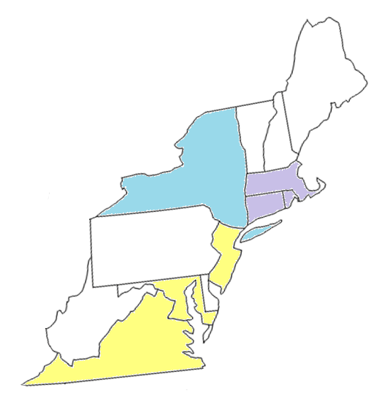
Offshore Wind Goals In East Coast RTO/ISO States
State | Goal (MW) | Procured (MW)
Massachusetts | 3,200 | 800
Rhode Island | 1,000 | 430
Connecticut | 1,000 - 2,000* | 300
New York | 9,000 | 130
New Jersey | 3,500 | 0
Maryland | 1,200 | 368
Virginia | 2,000 | 12
Total | 21,900 MW | 2,040 MW
* Legislation under discussion

Slide 4
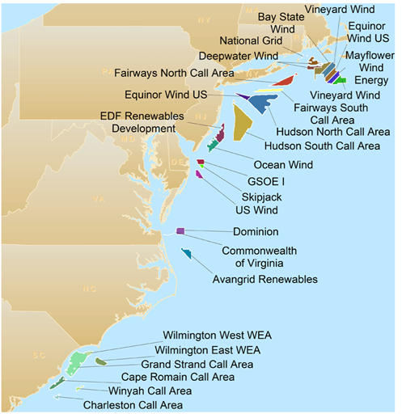
Leaseholds In BOEM Wind Energy Areas

Slide 5
Much to Learn from the European Experience
In Europe, with more than 14,000 megawatts of offshore wind developed since 1991, planning transmission has gained traction and generation and transmission are increasingly owned and developed by different companies.
United Kingdom 8054 MW 1927 turbines
Germany 6382 MW 1305 turbines
Denmark 1294 MW 495 turbines
Netherlands 1118 MW 410 turbines
Belgium 1189 MW 274 turbines
Notes:
Europe expects to have 25,000 megawatts of capacity by 2020. Belgium under construction numbers are 1076 and 125 turbines. Germany has more under construction and 1500 more will be procured in 2019

Slide 6
A European Perspective From Hard-Earned Experience
“Policymakers need to recognize that the ocean, if it’s to serve as a dominant energy source, must have its own planned, independent, offshore grid. In other words, governments should think beyond early procurements and insist on infrastructure that can support long-term growth.”
Wilfried Breuer, Managing Director of TenneT

Slide 7
New York Has Formally Endorsed Planned Transmission
New York’s Governor Cuomo called for 9,000 MW of offshore wind in his 2019 state of the State address. In so doing, he also called for the development of an offshore transmission system, stating:
“Transmission: Initiate a first of its kind effort to evaluate and facilitate the development of an offshore transmission grid that can benefit New York ratepayers by driving down offshore wind generation and integration costs.”

Slide 8
Recent Brattle Group Study Findings
A recent Brattle Group report (May 30, 2018) found that a planned offshore grid would provide open access to enable more competition between wind developers and between experienced transmission developers – and that competition will lead to lower prices.
The study also determined that with 8,000 megawatts of combined offshore generation under consideration for MA, NY and NJ, offshore grids that integrate multiple wind plants “would create scale economies and reduce the number of necessary landing points.”

Slide 9
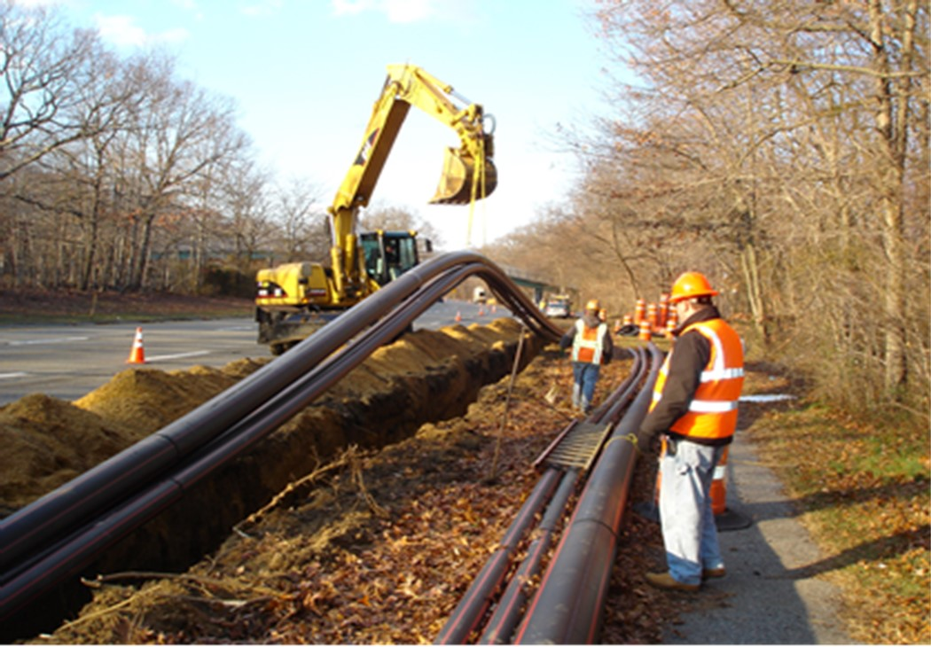
Planned Transmission Helps De-risk Project Timelines
It’s important to plan the transmission to identify an efficient plan that optimizes ROW and on-land approaches.
On-land permitting can consume significant time.
Planning a transmission system first allows permitting to be undertaken and be in place so that system can be quickly expanded.
Notes:
This shows installation of the on-land portion of an Anbaric HVDC project.

Slide 10
Benefits of Networked Planned Offshore Transmission
Planned transmission now being recognized in the Northeastern United States as the most cost effective way to reliably interconnect large quantities of offshore wind with:
Less environmental impact
Fewer high capacity cables means less ocean trenching of the sea floor
Fewer high capacity cables means reduced impacts on fisheries
The most reliability and resiliency
Multiple network cables means that power from each windfarm has multiple paths to shore instead of just one – allowing for power to flow if a circuit is lost or out for maintenance
Controllable lines in a network system make large amounts of offshore wind a solution for New England’s fuel security issues, eliminating RMR payments to fossil plants
The way to optimize limited seafloor ROW and limited onshore substations
Multi-State Cost Sharing Directly or Through Order No. 1000 Public Policy
Enables competition between wind farms because generators don’t need to bring their own transmission system

Slide 11
What Does Large-Scale Enabling Transmission Look Like?
RTO/ISO Control Area
Open access
Transmission Platform Project
Anticipated, yet not defined, offshore wind generation
Gen-tie for planned offshore wind generation

Slide 12
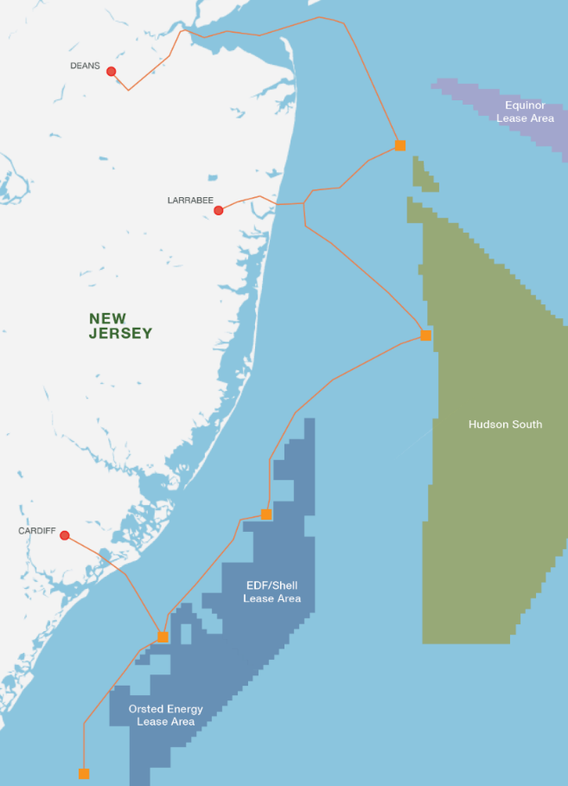
New Jersey OceanGrid
Concept map of New Jersey Transmission System
New Jersey OceanGridTM
http://nj.anbaric.com

Slide 13
PJM Region Addressing Gaps for Enabling Transmission
PJM has undertaken a stakeholder process to ensure that transmission-first projects that enable the later interconnection of wind can be fully studied not just for HVDC (projects already under study), but also for AC configurations.
Problem statement issued early 2019
Expected tariff revisions summer 2019
This approach will help ensure open-access for grid-expanding projects that weren’t contemplated under existing tariff rules but are consistent with FERC’s Order No. 888 and Order No. 1000 principles

Slide 14
APPENDIX
Other Regions Have Studied And Deployed Successful Transmission-First, Grid-Expanding Open Access Projects

Slide 15
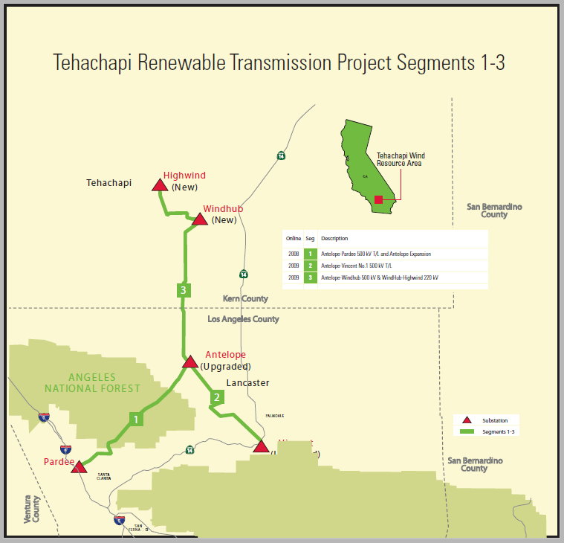
California ISO – Developed Rules Over 10 Years Ago
*The facilities in the circle are the remote generation (1,150 MW)

Slide 16
ERCOT
ERCOT planned a ~ 2,400 mile transmission-first grid expansion project
AC
Planned ahead of generation
Allowed for over 20,000 MW of wind to be quickly connected and integrated

Slide 17
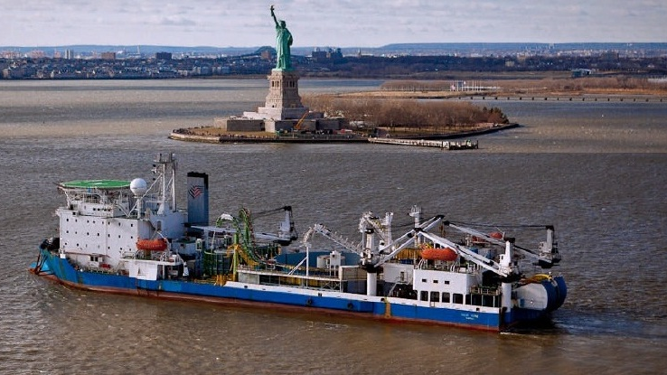
Questions and Discussion

